Slide 1
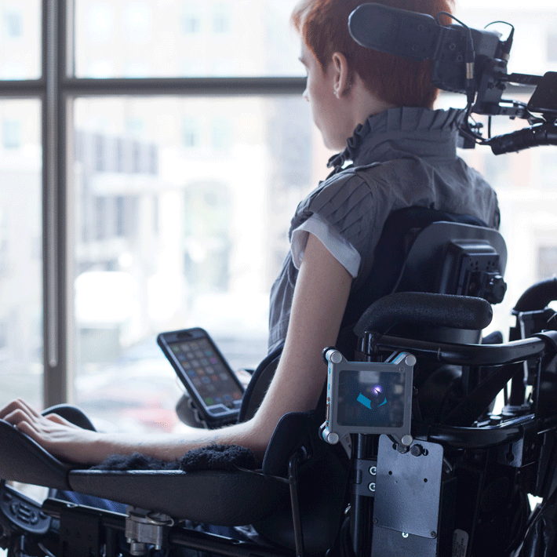
Benchmarking
Best-in-Class for
Online Telecom Accessibility Resources
David Fleming, Accessibility Analyst
Confidential and proprietary materials for authorized Verizon personnel and outside agencies only. Use, disclosure or distribution of this material is not permitted to any unauthorized persons or third parties except by written agreement.
Notes:
Overview This high-level, benchmarking research is focused on the comparative analysis of the way accessibility information and resources are presented online by our competitors, namely, Sprint, AT&T and T-Mobile. This study also covers benchmarking of the best-in-class Corporate Accessibility Champions such as Apple, Google and Microsoft. What are our best outcomes in doing this study? This study gives us a solid baseline of understanding, enabling us to augment the resources we have in place now, as well as take advantage of some other revenue associated opportunities that have come out of this study.
Verizon Innovative Learning opportunities – shown in the photo In supporting accessibility overall, it’s important to understand all the ways that we can reach out and help. Later in the presentation, I’ll discuss an opportunity that combines the Verizon Foundation, Verizon Innovative Learning and the Verizon Wireless Accessibility team.

Slide 2
Contents
Understanding the Telecom Accessibility landscape
Methodology Review
Solutions Discussion
Next Steps
Notes:
At a high level we will be reviewing the following:

Slide 3
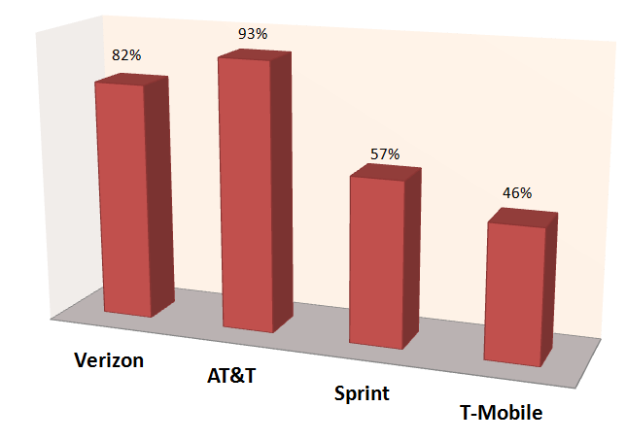
The Telecom Competitors’ Landscape
As we look at the competition, it’s clear to see that AT&T ranks the highest. But the comparative landscape is complicated and requires a closer look at how these assessments have been made. The Telecom ranking in this report utilizes an adaptive, Comparative Analysis Matrix, driven by a holistic research approach. Okay, that’s a mouthful, so let me break it down in plain English. This methodology gives us the flexibility to adjust the weight of any dimension of the study, opening up the research for any interested Verizon partner. In short, if we want to drill down deeper to validate the results, we have the means to do so.
Notes:
As we look at the competition, it’s clear to see that AT&T ranks the highest. In the following slides we will explore why and review the research methodology used to arrive at those conclusions.

Slide 4
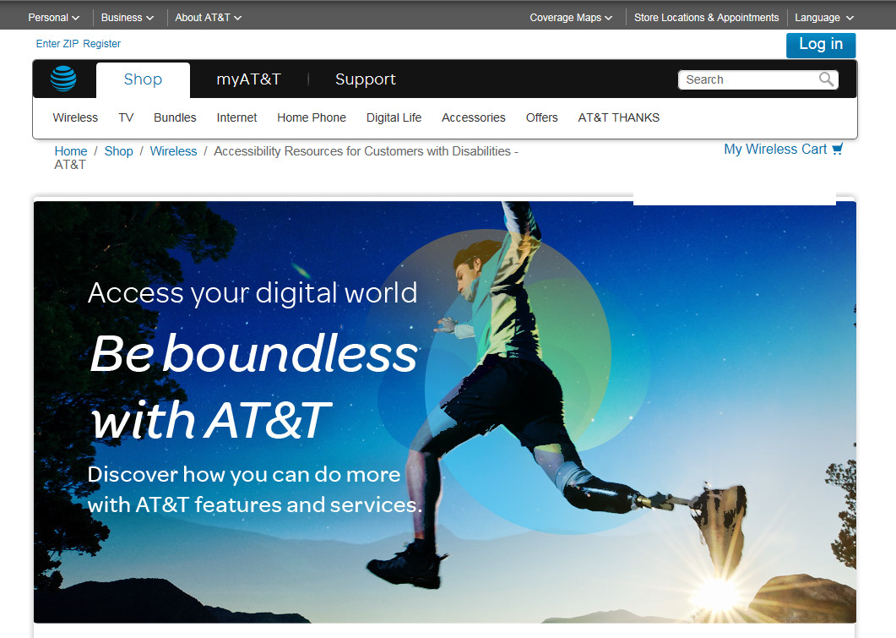
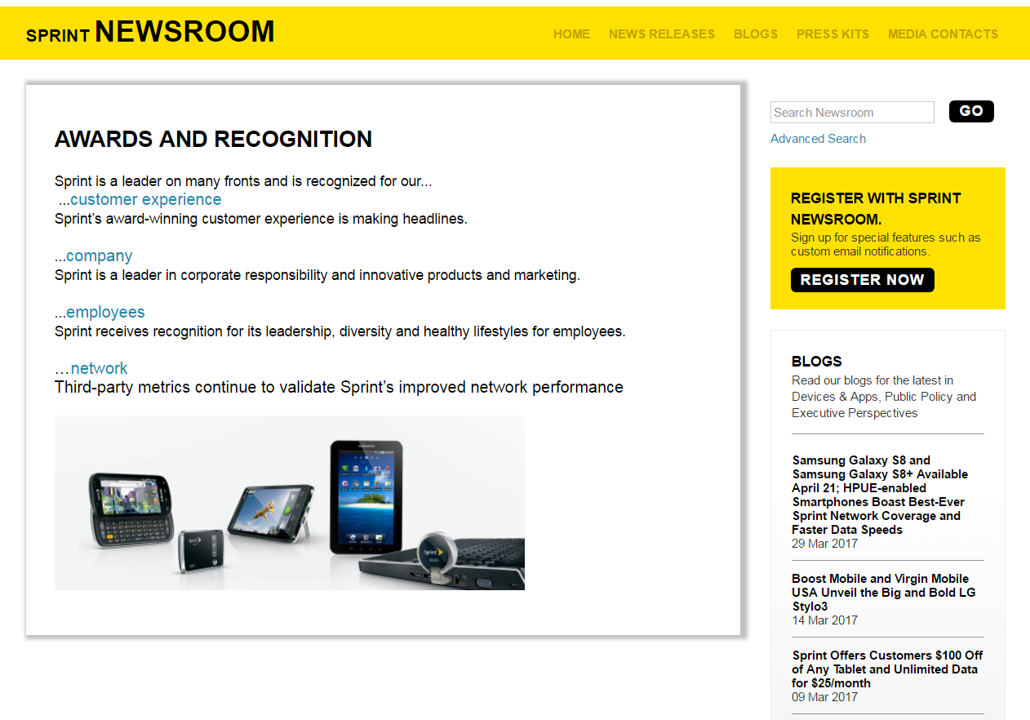
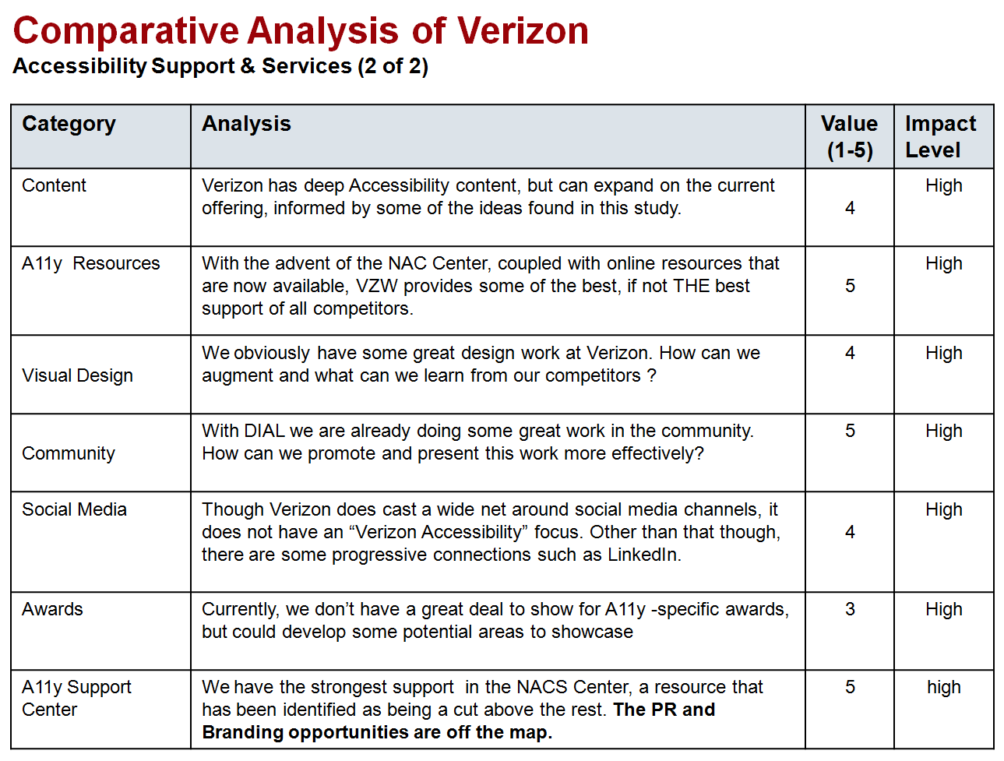
Research Methodology
How did we arrive at these conclusions?
Visiting each competitor’s website: AT&T, Sprint and T-Mobile, we used the Comparative Analysis Matrix to assess each Telecom. That matrix lists a range of categories that were than ranked, assigning values to their features, functions and content. The categories of assessment are based on a holistic approach that extends across the best practices of correlated research disciplines, such as: Accessibility Compliance, Content Strategy, Usability Heuristics, Information Architecture, and “Design Thinking”, A.K.A., human-centered design
Subject Matter Expert interviews were conducted with a Verizon A11y Corporate Attorney, Zack Bastian, and a Verizon employee with a disability who is also an Accessibility Defects Tester.
Notes:
We arrived at these conclusions using a Holistic Research approach. The core foundation of the research is predicated upon a Comparative Analysis Matrix that gives us a foundation of baseline data sets. This gives us a flexible way to tweak the values wherever needed. Using a matrix with weighted values enables us to provide the most accurate and reliable benchmarking information. Keep in mind that other Verizon teams can participate, by giving their input on any data set, allowing us to refine the analysis with Verizon professionals who bring their own expertise to the table.
Overall, this report provides the best possible tool to ensure that we understand who the competition is, why they excel, and what we can do to surpass them. At the end of the day, we have created a solid roadmap

Slide 5
Comparative Analysis of Verizon Accessibility Support & Services (1 of 2)
Category | Analysis | Value (1-5) | Impact Level
Content | Verizon has deep Accessibility content, but needs to consolidate, organize and capitalize on more strategic positioning, navigation and placement. We can also augment some of our existing resources. | 4 | High
A11y Resources | With the advent of the NAC Center, coupled with online resources that are now available, VZW provides some of the best, if not THE best support of all competitors. | 5 | High
Visual Design | We obviously have some great design work at Verizon. How can we augment and what can we learn from our competitors ? | 4 | High
Community | With DIAL we are already doing some great work in the community. How can we promote and present this work more effectively? | 5 | High
Social Media | Though Verizon does cast a wide net around social media channels, it does not have a specific “Verizon Accessibility” focus. However, there are quite a few places where we can leverage and integrate progressive content, such as LinkedIn and on Twitter. | 4 | High
Awards | Currently, we don’t have a great deal to show for A11y -specific awards, but could develop some potential areas to showcase | 3 | High
A11y Support Center | We have the strongest support in the NACS Center, a resource that has been identified as being a cut above the rest. Are the PR and Branding opportunities are off the map? | 5 | high
Notes:
As you can see, this matrix is fairly dense with information. I won’t drill down on the details, but suffice to say that the analysis is a general snapshot of the overall content, features and functions for each Telecom. As mentioned already, the matrix is flexible enough to build on over time, if we wanted to get more specific. For now, I think it’s enough to show us where we can derive the most benefit moving forward.

Slide 6
Comparative Analysis of Verizon Accessibility Support & Services (2 of 2)
Category | Analysis | Value (1-5) | Impact Level
Customer Experience | Navigation can be improved to help visitors more easily find accessibility content. Consider the examples given on slides 46-49. | 3 | High
A11y Overview & PDF Download | We don’t have this resource yet, but what’s stopping us from creating and offering this critical A11y content? | 1 | High
Video channels | Even though we have a YouTube channel , does it provide enough content on A11y support? https://www.youtube.com/verizon Or, are PWD less likely to look here for content? What about others who can become inspired by what we do? | 3 | Med
Products | Mobile First, along with many other new products, continue to roll out. | 5 | High
A11y Compliant | Based on the comparative WCAG automated tool, POWERMAPPER. | 3 | High
Forums | There are Verizon Forums but not A11y specific forums (?) | 3 | Low
Blogs | We have a lot of content that showcases what we do, but we could do more with an A11y Blog. | 3 | Low
SEO, Search & Search Results | A Verizon search, using the term “Accessibility” returned 241 results. Notwithstanding a higher total number of results on AT&T, Verizon has more meaningful results and information. | 5 | High
Notes:
This is the second screen of the comparative input. I would just like to point out one thing here – on the far right column, you will notice that the Impact levels range from High to Medium to Low. This enables us to become more granular and also more collaborative, opening up the matrix to other SME’s that might recommend adjustments to the values and weighting of the data shown here. Again, that could become more labor intensive than what we have budgeted for this project.

Slide 7
Solutions
Notes:
The following slides present recommended solutions along with proposed next steps for moving ahead.

Slide 8
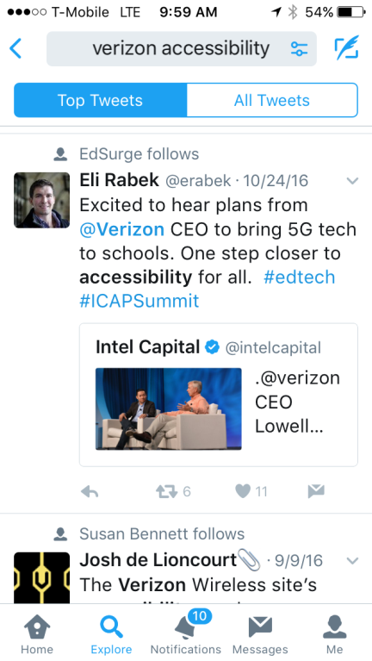
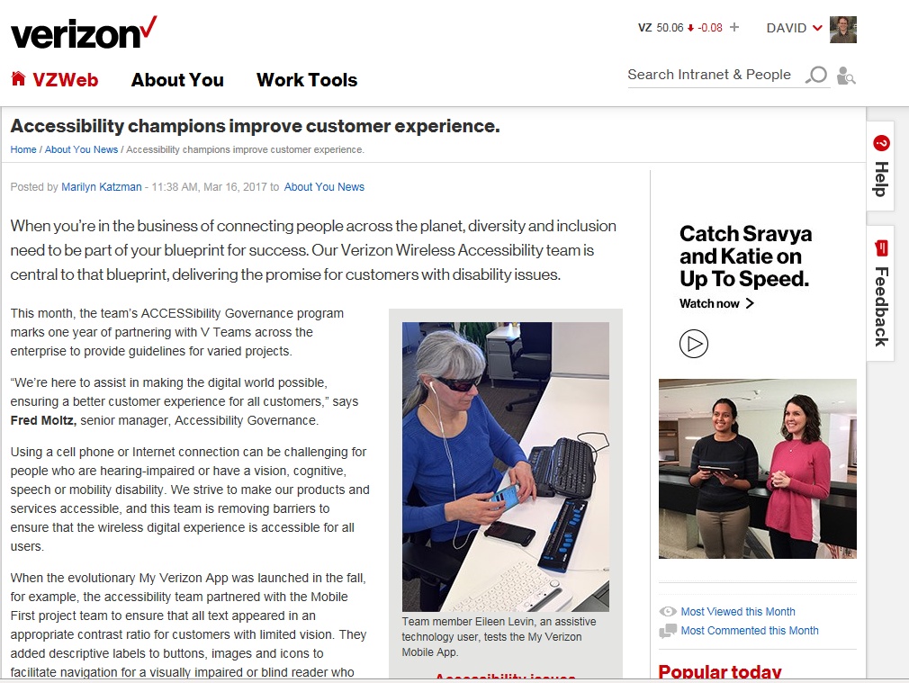
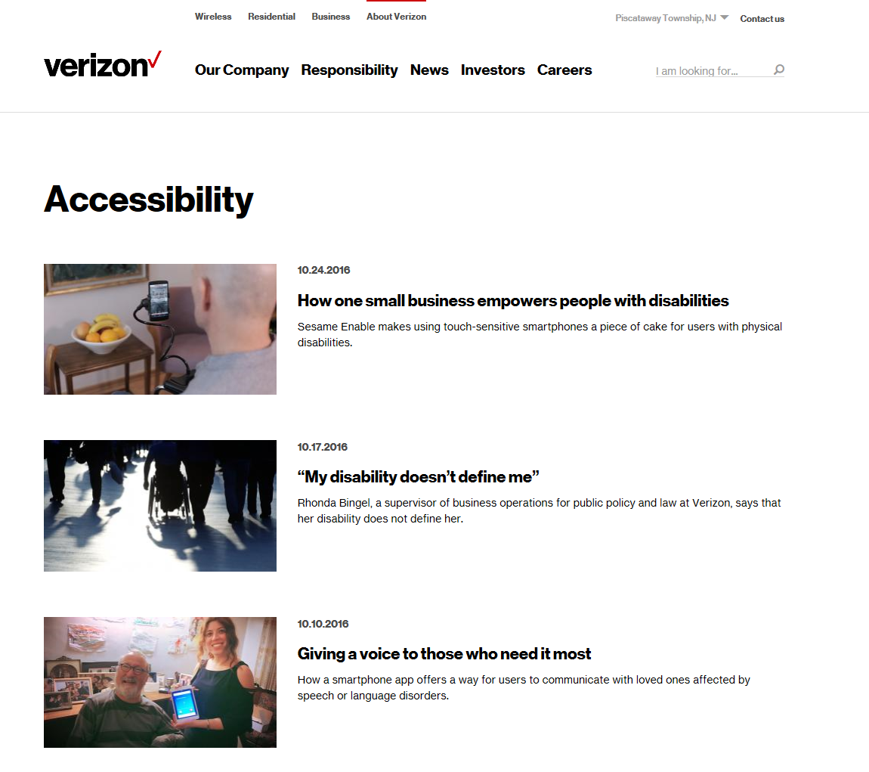
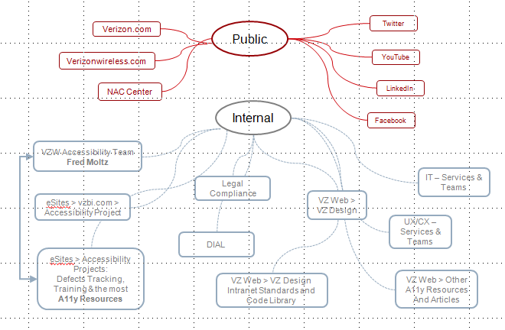
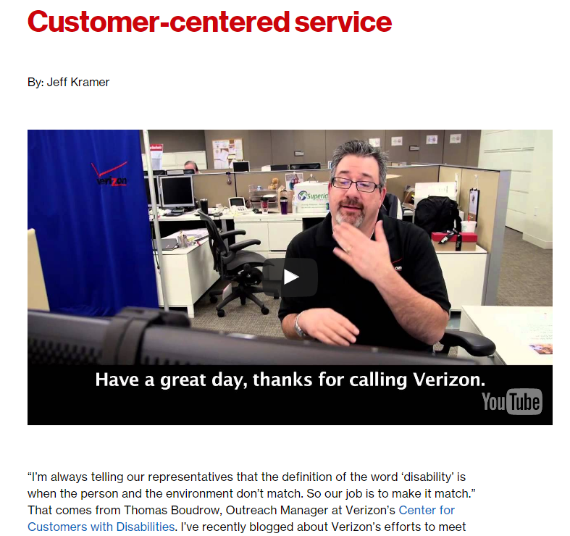
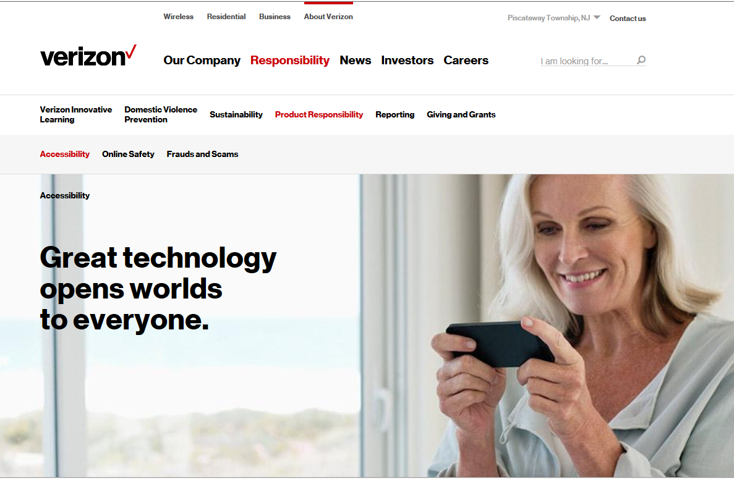
1. Consolidation and embellishment of Verizon Accessibility Resources
Notes:
Our Accessibility resources and content are arguably the best around, containing more depth than any of our competitors. However, we lack a more cohesive organization of those resources, prompting us to consider new strategies to consolidate our A11y information. I propose that we focus on the following action items:
Consolidate all of our A11y content into one main body of more cohesive information
Reorganize the content overall
Consider the development of micro-sites where applicable, such as the NACS Center and/or an Verizon A11y blog
Ensure that the flow of pages is consistent with Usability Heuristics and Information Architecture standards, ensuring the best possible customer experience, as well as assuring the best possible internal user experience for all team members.

Slide 9
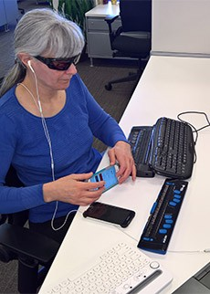
2. Learning from People with Disabilities
Problem – Little input from people with disabilities We don’t really know what Assistive Technology users encounter unless we are able to study them as they navigate through the varied landscape of Verizon product information, conducting their typical goals online.
Solution – Defect & Usability testing of people with disabilities Ideally, we could conduct user testing studies to help us understand more about the difficulties they encounter. Internally, we have a distinct advantage in being able to work with Verizon Wireless Accessibility team members that have disabilities, but who also have a high level of professional expertise working with Assistive Technology and the use of Defects Tracking tools.
To date, I’m not aware of any extensive testing that has been done that will enable us to follow the not-so-happy path that people with disabilities must undertake. If we are going to truly serve people with disabilities as best as we can, it’s good time to get this started.
Notes:
In order to learn more about the way people with disabilities experience Verizon.com, I did an interview with our blind colleague, Eileen Levin. Eileen is uniquely qualified in this field, due to her extensive knowledge of Assistive Technology solutions – such as screen reading software, AT apps, Braille keyboard, etc., and most importantly, is a highly skilled Defects tester.
If we can get this sort of research going, it will enable us to learn first-hand what it’s like for them to navigate though the areas of the Verizon website, calling out where the most difficult problems arise. An outline of the best outcomes would look like this: 1) We get direct feedback from people with disabilities using Verizon. 2) Learning more from people with disabilities, Verizon is able to resolve transactional and other revenue associated parts of the website. 3) With an improved experience, it is not a far stretch to assume that Verizon can attract new customers – those with disabilities and those who are impressed with the way we serve people with disabilities.

Slide 10
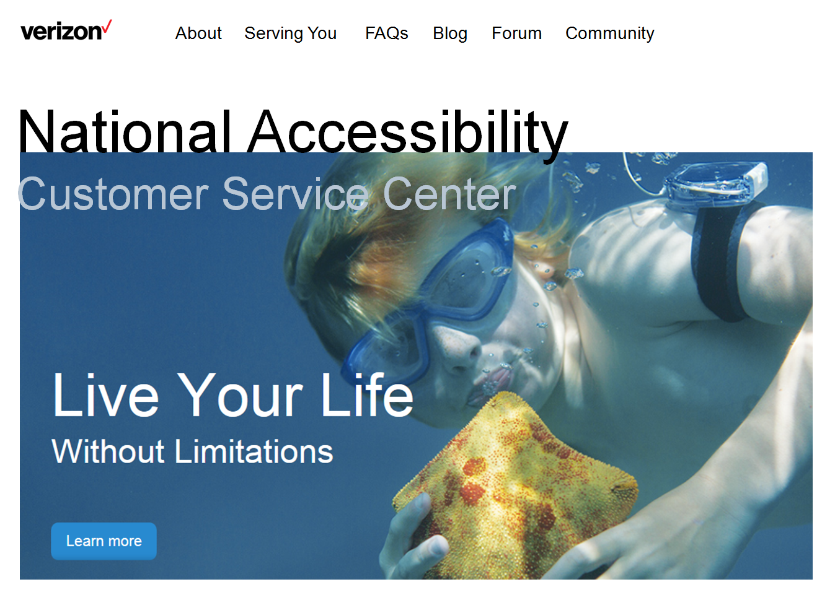
3. An A11y “Gold Standard”?
What are the advantages of a NACS Center microsite?
The NACS Center has already gained considerable attention in recent studies
The support offered ranks above all other Telecoms
A NACS Center landing page will give that team a way to provide ongoing news and current resources
The news of a landing page can be leveraged in marketing campaigns and through social media channels
More visibility translates into more sales
More visibility will translate into more support for people with disabilities
Notes:
When we think of all the things we can do to position ourselves beyond our Telecom competitors, one of the most important solutions to consider is answering the question: how do we discover and promote our own Accessibility Support “Gold Standard?” So what does that actually mean? One of the best examples out there what we’re describing as the Comcast “Gold Standard.” In this example, Comcast was able to forge a convergent solution that turned into a win, win, win outcome: Comcast customers with disabilities won; Comcast business won – through increased sales; Comcast marketing won because they had a PR dream coming true that could easily; And lastly, the global impact can be felt as more companies strive to emulate the Comcast innovations, which in turn helps all people with disabilities.

Slide 11
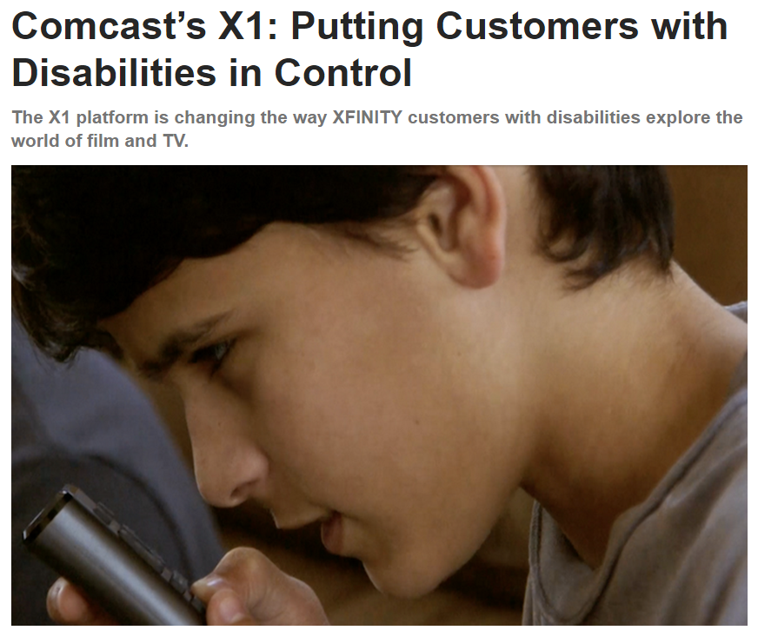
Comcast’s “Gold Standard”
Evolving* The way that Comcast developed the “Talking Guide”, is a Gold Standard example of how to take Assistive Technology mandates and turn them into wins on every level possible: the A11y community wins, and the enterprise branding and business wins. In this example, Comcast developed, rolled out, and then branded the industry’s first voice-enabled television user interface, revolutionizing the way XFINITY TV customers navigate the X1 platform.
The end result of their work has yielded a great example of what can be done when innovation meets up with solving practical access challenges. Outside of the Apps that Verizon develops, are there other ways that we can outshine our competition? Consider the advantages of a NACS Center website.
Notes:
Talking Guide – is Comcast’s innovative solution and a great example for us to learn from and where possible - emulate.

Slide 12
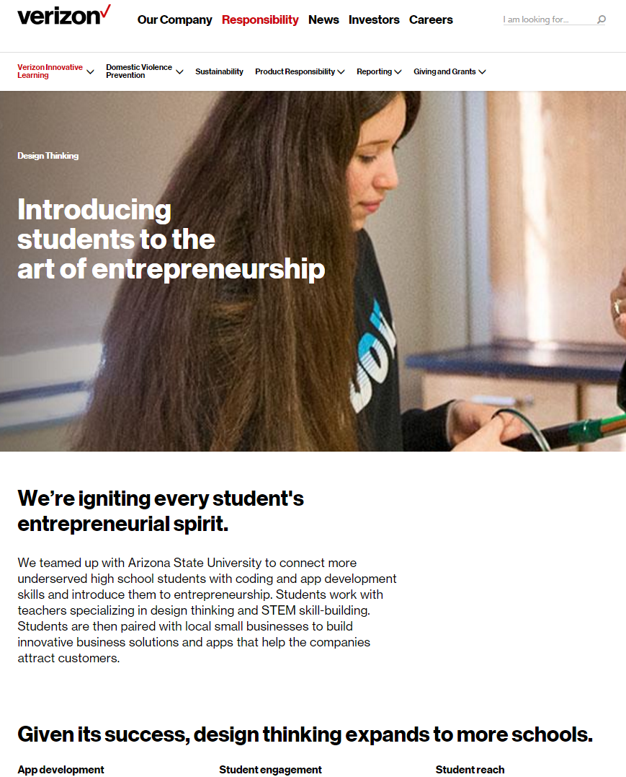
4. Can VIL develop educational programs that include underserved students with disabilities?
“Students work with teachers specializing in Design Thinking and STEM skill-building. Students are then paired with local small businesses to build innovative business solutions and apps that help the companies attract customers.”
What if the Verizon Innovative Learning developed a program in a School for the Blind?
Notes:
The Verizon Innovative Learning (VIL) program is a well established initiative now funded by the Verizon Foundation. I see it as an opportunity to expand the Verizon Wireless Accessibility team’s support. After collaborating with Zack, a few new ideas have emerged:
Zack Ask the VIL program to consider including the VZW Accessibility team in helping the students ensure that the Apps they work on, are A11y compliant – giving our support to them by conducting defects testing.
Zack Ask the VIL organization to consider allowing us to help interject our methodology into the Design Thinking curriculum, offering a way to augment that training.
Essentially, these initiatives are focused on how we might be able to make a positive impact on the community.

Slide 13
Historical Insights
People with Disabilities (PWD) are the poorest, least educated and largest minority
- Congressional Committee findings during ADA testimony
Two-thirds of PWD's of working age are not working, according to the Louis Harris poll. This includes all other demographic groups, including African-Americans. PWD's maintain above average work attendance and productivity, while employer fears concerning expensive insurance premiums, are unfounded, as well as claims that expensive modifications are required on worksites. Lou Harris poll finds that 3/4 of business managers feel that PWD's "often encounter job discrimination from employers." PWD's with mobility permits cannot get transportation to their job. 2/3 of those not working, want to work. This staggering unemployment rate does not stem from the lack of desire to work. Studies show that PWD's perform as well or better than their co-workers. ADA Committee Reports find that 8.2 million PWD's want to work.
Over 20 % of PWD's of working age, live in poverty. PWD's have more than twice as high a poverty rate as other Americans. About 1/2 of PWD's live in households with $15,000 or less, double the proportion of people without disabilities Only 12 % live in families with incomes higher than $35,000, less than half the 27 % rate for other Americans. Almost 2/3 of PWD's did not go to a movie in last year. 3/4 did not see live music performance. 2/3 of PWD’s saw no sporting event. 17% never eat in restaurants. 13% never shop in grocery stores. 40% of PWD's did not finish high school. 36% of PWD's are dependent on government support. Another 25% get no support from government yet do not work.
Support programs cost US $60 billion annually of Federal Aid. 93-95% of Federal government for PWD's, went for income, support and maintenance. PWD's are subject to widespread and severe discrimination, and are extremely disadvantaged. This all creates a tremendous economic cost overall.
David Fleming, Accessibility Analyst
Notes:
I’m including this historical information because most of us don’t really know how bad things are for people with disabilities. Knowing that we can make a difference – even if for a small number of people – shouldn’t we do everything we can to lend our name and our efforts to this cause?

Slide 14
5. The ROI of developing a ACCESSIBILITY Pattern Library
Where and how we benefit …
A predictable cost reduction in defects analysis occurs after the library is utilized enough to establish a secure and reliable foundation of Accessibility Models, Patterns and Requirements.
Ease of use – a well organized library will make it easy for the Verizon internal users to find what they want and do their work more easily
A Pattern Library makes it easier to onboard new contractors, reducing the overall time required to educate.
A resource like this enables Third Party Vendors to more quickly ramp up on projects that require A11y knowledge.
Cost reduction includes: repetitive defects that can be avoided when we aren’t recreating the wheel with each A11y code model.
Pattern Libraries are used successfully in other organizations, giving us some historical validation of the ROI models.
A Pattern Library would contain and provide: Accessibility Patterns, Visual Design Patterns, IT Accessibility Resources and Verizon Brand Standards.
Notes:
When it comes to down to answering the question: why does it take longer to conduct defect testing compared to UAT, it’s important to address the overall process and discuss ways to improve the workflow overall. Developing a Verizon Pattern Library that includes Accessibility, IT, Marketing and Brand Guidelines, is one approach that we could take.
It’s worth noting that some of the key team members on our VZW Accessibility team, are in favor of this plan and have thought of doing a similar initiative.
Favorable input includes: Imran, Eileen, Mark (noting the potential, but wanting to discuss in a timely, strategic way), previous employees – Stew.
Historically, PL’s are used throughout the corporate world and have been accepted as viable ways to improve efficiencies and save money.

Slide 15
Inside an Accessibility Pattern Library
The Advantages
Accessibility Patterns and Requirements Documentation
IT Accessibility Resources, possibly related code examples
Verizon Brand Style Guides
Usability Guidelines
Visual Design Patterns
A collaborative space for Verizon teams to communicate about Accessibility challenges and concerns
An adaptable and evolving format that can quickly change, keeping pace with technology The ability to connect with JIRA, the web and Confluence working environments
A unified platform to more efficiently govern web content operations overall
Notes:
If we are looking at the potential value of a Verizon Pattern Library, it’s helpful to review what it can provide and who will benefit.

Slide 16
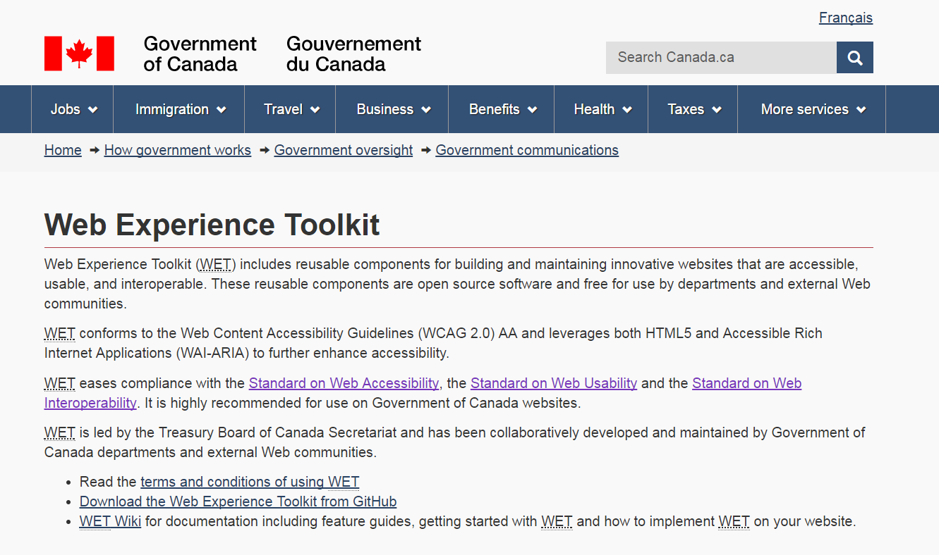
The Canadian Government’s A11y Solution
One of the strongest arguments to be made for implementing A11y Pattern libraries, is found in the Canadian Government’s Accessibility Support solution for all their websites.
The Massachusetts State Government’s IT had this to say:
“"Ever wish all federal government websites were run on common components that are accessible and secure? The Government of Canada has taken this unique approach to Web management and built a platform of standards-compliant (W3C and WCAG) components that its agencies use to build and maintain their sites. Each website can apply unique themes to control its look and feel, but the themes all run on top of these common components, ensuring their sites are accessible and secure. The reusable components of the Web Experience Toolkit (WET) are open source software and free for use by departments and external Web communities."
Notes:
Here’s a quote from the site: “Web Experience Toolkit (WET) includes reusable components for building and maintaining innovative websites that are accessible, usable, and interoperable. These reusable components are open source software and free for use by departments and external Web communities.”

Slide 17
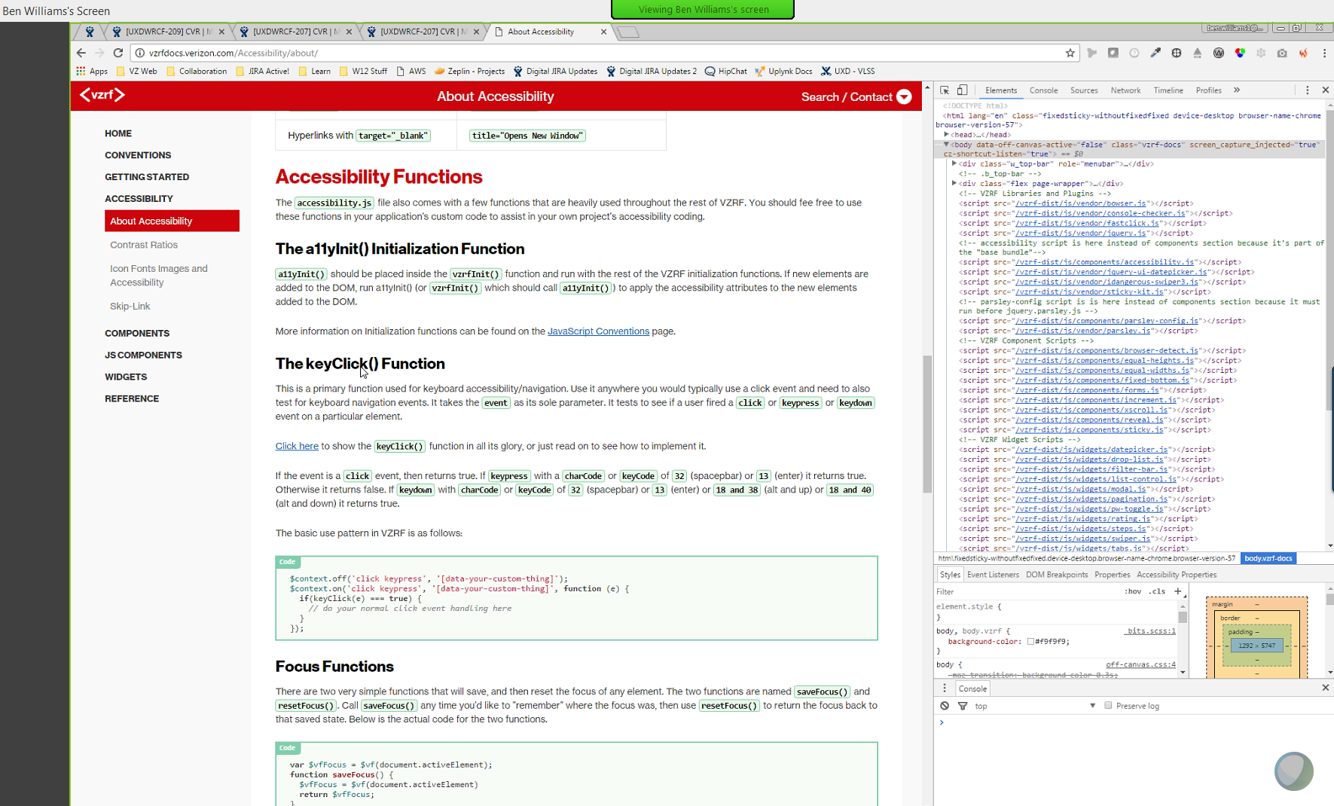
IT & Accessibility Patterns: Collaboration opportunities?
A Quick Glance at the Best Outcomes:
One stop shop for all A11y resources
Team members can rely on self-service vs. waiting on others to get back to them
Outside agencies can more easily learn the A11y landscape
Regular governance meetings can help the entire project to stay on track and evolve
A Pattern Library brings more continuity to all design elements, code and Accessibility support models, such as Carousels or Modal Windows.
Notes:
Collaboration requires a lot of discussion and agreement. These ideas are meant to initiate the discussion.

Slide 18
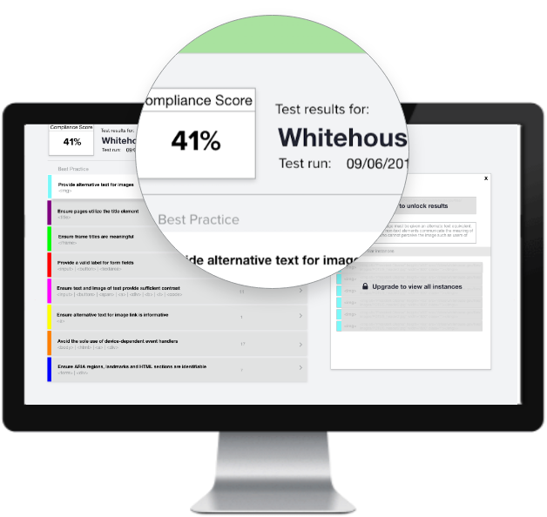
A Recap of Proposals
Discovering our own Accessibility Gold Standard
Assess ways to consolidate all Verizon A11y content and make it easier to access the information across Verizon
Ensure that the critical paths to information are user friendly and easy to find
Consider new ways to improve A11y navigation, such as improving our menus - Make it better than Sprint!
Embellish and augment our general resources – Can we do it better than AT&T? Of course!!
Develop and offer a PDF download that showcases and promotes our A11y work, services and best practices
Where possible, promote more community related news and articles that emphasize our progress.
Consider the value in designing and developing a website and/or landing page for the NACS Center
Verizon Innovative Learning – Is there a way to support students with disabilities within the existing curriculums? More discussion is needed, but in progress.
Notes:
Discovering our own Accessibility Gold Standard
Assess ways to consolidate all Verizon A11y content and make it easier to access the information across Verizon
Ensure that the critical paths to information are user friendly and easy to find
Consider new ways to improve A11y navigation, such as improving our menus - Make it better than Sprint!
Embellish and augment our general resources – Can we do it better than AT&T? Of course!!
Develop and offer a PDF download that showcases and promotes our A11y work, services and best practices
Where possible, promote more community related news and articles that emphasize our progress.
Consider the value in designing and developing a website and/or landing page for the NACS Center
Verizon Innovative Learning – Is there a way to support students with disabilities within the existing curriculums? More discussion is needed, but in progress.

Slide 19
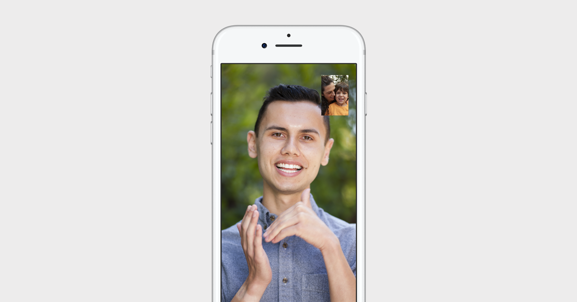
Proposals (Cont’d)
By Collaborating with Verizon Marketing, we could support Integrated Marketing Campaigns that present and promote A11y content and resources.
For example, using our social media resources, we can connect LinkedIn articles and Twitter references authored by our CEO, Lowell McAdam
Are we doing enough to communicate across the widest spectrum of cultural diversity? Review and discuss what we can do in other regions and in the global community –What about Millennials? Disenfranchised populations?
We can help visitors understand our accessibility policies by showcasing our legal compliance support – Make it similar to Microsoft’s information, but better!
Modeling after the Accessibility Style Guide of the BBC and the Open-Source A11y Pattern Library, we have an opportunity to save money, spend less time tracking defects and make life easier for IT, if we can develop a Verizon A11y Pattern Library.
Ensure that all VZW A11y Content & Resources are compliant
Notes:
By Collaborating with Verizon Marketing, we could support Integrated Marketing Campaigns that present and promote A11y content and resources.
For example, using our social media resources, we can connect LinkedIn articles and Twitter references authored by our CEO, Lowell McAdam
Are we doing enough to communicate across the widest spectrum of cultural diversity? Review and discuss what we can do in other regions and in the global community –What about Millennials? Disenfranchised populations
We can help visitors understand our accessibility policies by showcasing our legal compliance support – Make it similar to Microsoft’s information, but better!
Modeling after the Accessibility Style Guide of the BBC and the Open-Source A11y Pattern Library, we have an opportunity to save money, spend less time tracking defects and make life easier for IT, if we can develop a Verizon A11y Pattern Library.
Ensure that all VZW A11y Content & Resources are compliant

Slide 20
About this study
This research covers a comparative review of our competitors, but is not an exhaustive study.. This means that we can gain a more refined understanding of what our competitors are doing in the A11y space, but we would need to conduct a deeper study to get there.
However, the value of this research has already resulted in some good insights and new directions to consider as we strive to evolve the Verizon Wireless Accessibility team’s content, services, impact and benefits. Moreover, there are other benefits that may not be so obvious, such as the positive social impact benefits and the potential revenue streams associated with this benchmarking study. The Impact Summary outline that follows goes into more detail about these opportunities.

Slide 21
Projected Revenue Impact
Potential Opportunities
This VZW Benchmarking Report gives us a dependable way to position ourselves as leaders in the A11y field
All data sets can be tweaked and validated
Becoming leaders in the A11y field strengthens our brand
A11y recognition can open up new sales channels
Discovering our own Accessibility Gold Standard
For example, bringing more awareness to the progress and value of the NACS Center by designing and launching a micro-site that showcases what they provide and what they have accomplished
Brings power to the brand and has the potential to bring in revenue streams from new customers
Helps to foster public awareness
Empowers the A11y community when it becomes easier to access this information and these services
Integrated Marketing Campaigns
Can drive more customer interest and thereby sales
Builds more value in our brand by showing that we say we care and we’re continuously taking steps to make a difference for people with disabilities
Developing an A11y Pattern Library
Based on corporate models that are known to saves time, save money and make work easier all the way around
Decreases defects overall
Gets our teams on the same page: IT, A11y, Designers

Slide 22
Q & A

